Slide 1


INFO6150 Web Design & User Experience Engr
P A Y B A C K
by ‘The Akatsuki’
Mayur Chaudhari - 002736792
Siddhant Nagraj - 002794527
Jash Pandav - 002728124
Swanand Tanavade - 002774342

Slide 2

Project Description:
PAYBACK is essentially an expense tracker and an expense splitter application developed using HTML, SCSS, JS , REACT and MongoDb
This project will consist of multiply logins for multiple members.
A dashboard will consist of a feature that will allow user to perform CRUD operations on added expenses.

Slide 3

The Purpose
Substituting the traditional pen and paper method of expenditure recording with a web application.
Through graphical depictions, Payback enables you to track your expenses and obtain more thorough reports.
It helps you be more responsible for your actions, increases financial security, and lowers financial stress.
Spending less money and staying out of debt.

Slide 4

Features
Created REST API for Expenses and Users, fetching the expenses of individual user.
Multiple user can register. Only Admins have to permission to handle expenses.
Users can add group expenses and split them as per the needs of the group.
Users can settle up expenses between involved parties.
Expenses added and settled would be visible to both lender and borrower.

Slide 5

Contributions Made :
Mayur Chaudhari Design of UI, Sign in, Sign out, header, landing pages, SCSS, Javascript.
Siddhant Nagraj Design of UI, Designing Dashboard, Dash-Header and pop-ups pages, Javascript, SCSS.
Jash Pandav React , Model , Helpers Designing, MongoDB.
Swanand Tanavade Redux implementation, Routes, Utilities, MongoDB.

Slide 6




Technologies Used
NODEJs
Express
MongoDb
React
Redux
HTML
SCSS
Javascript

Slide 7

References Used :
https://www.amcharts.com/docs/v4/
https://mui.com/getting-started/usage/
https://v5.reactrouter.com/web/guides/quick-start
https://react-bootstrap.github.io/layout/grid/
https://www.npmjs.com/package/react-axios
https://developer.mozilla.org/en-US/docs/Web/JavaScript
https://developer.mozilla.org/en-US/docs/Web/Web_Components

Slide 8
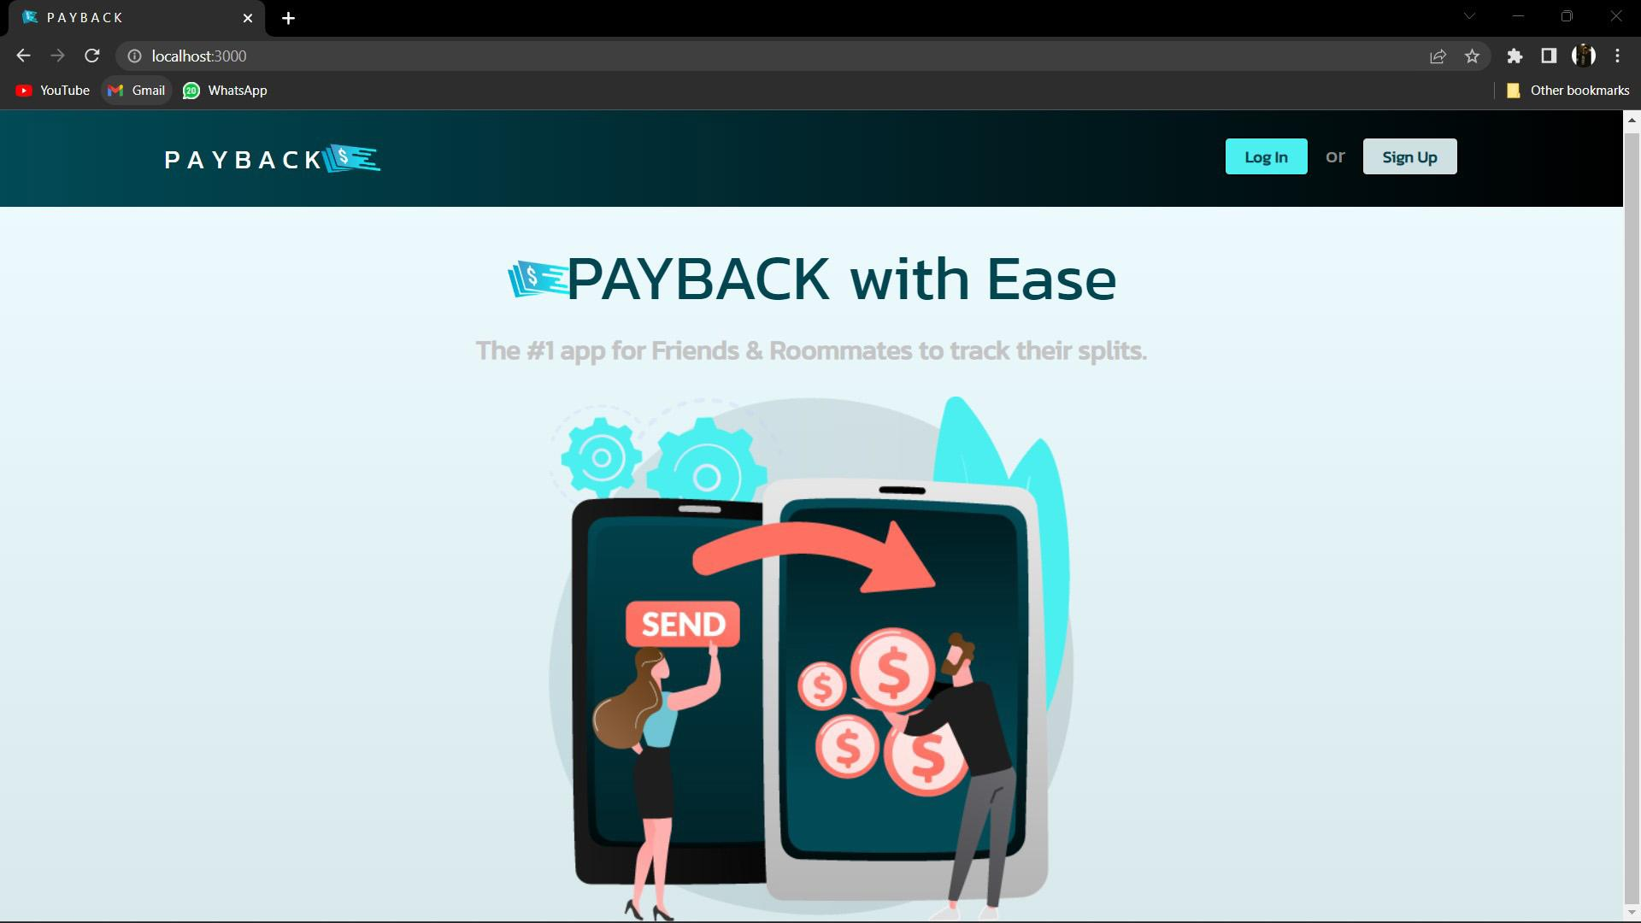
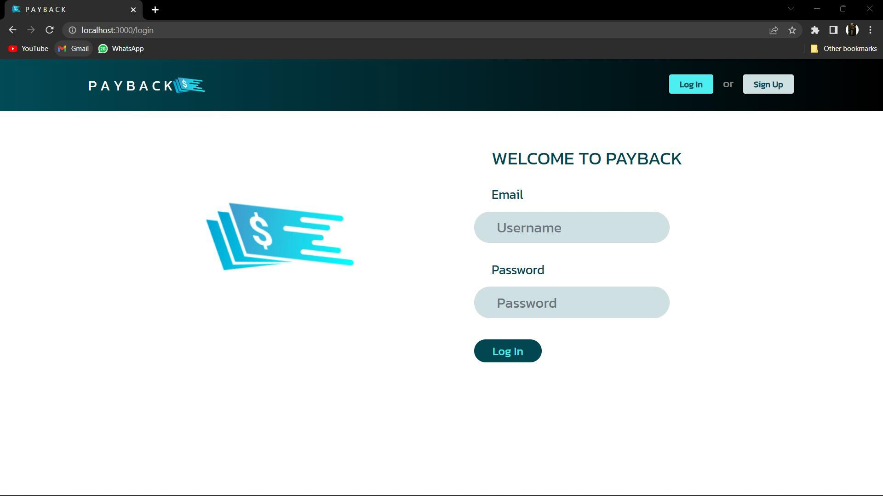
Screenshots :

Slide 9
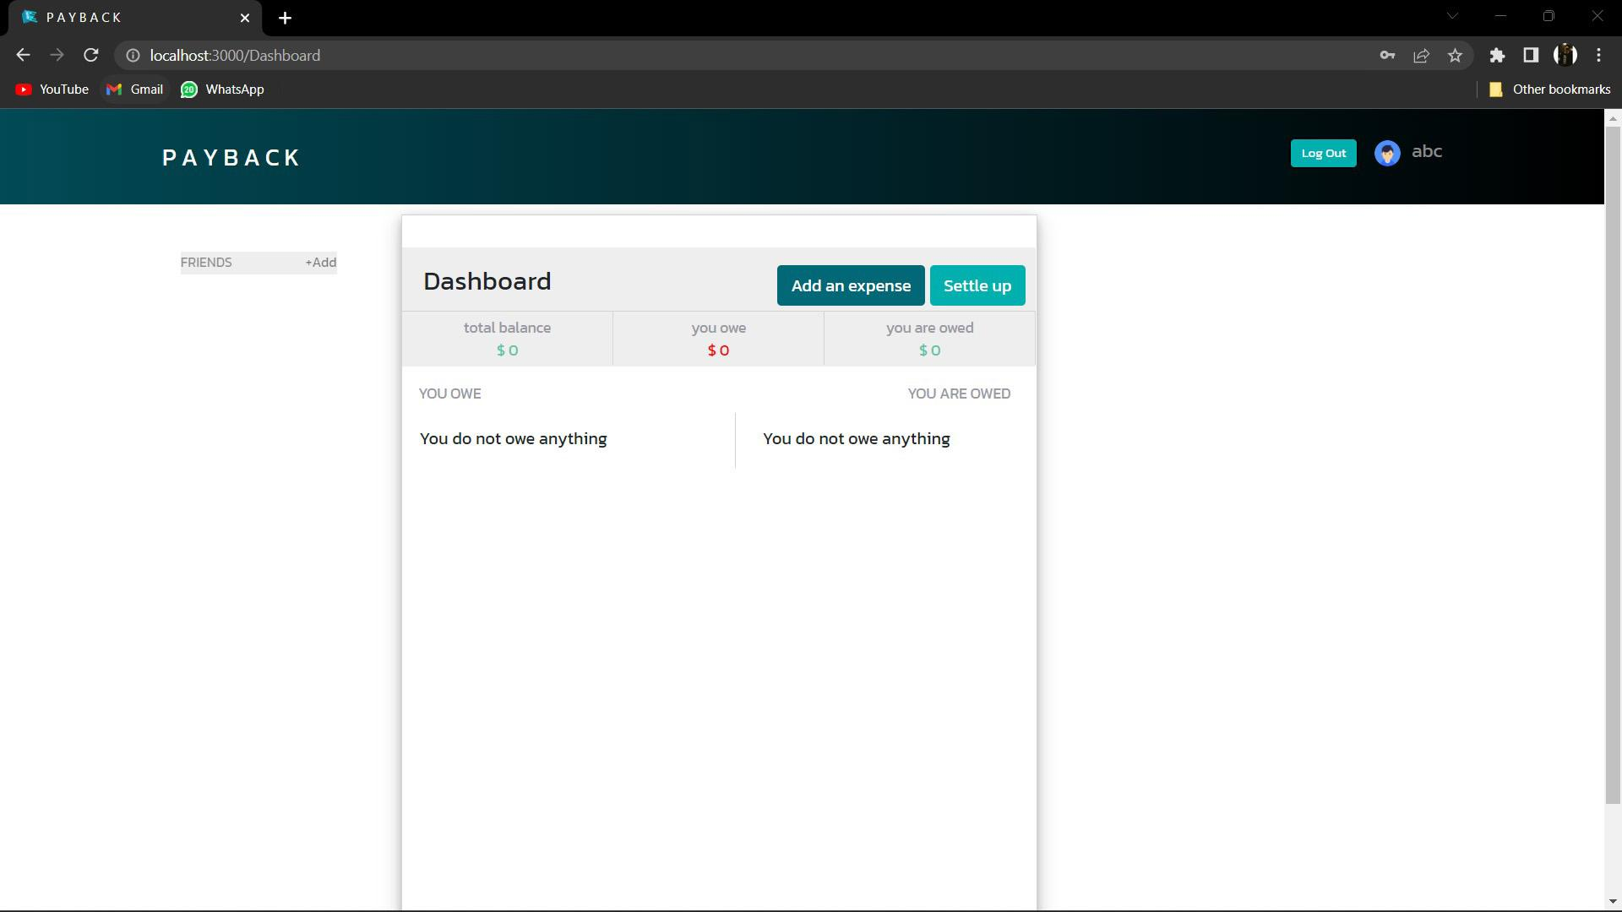
Screenshots :

Slide 10
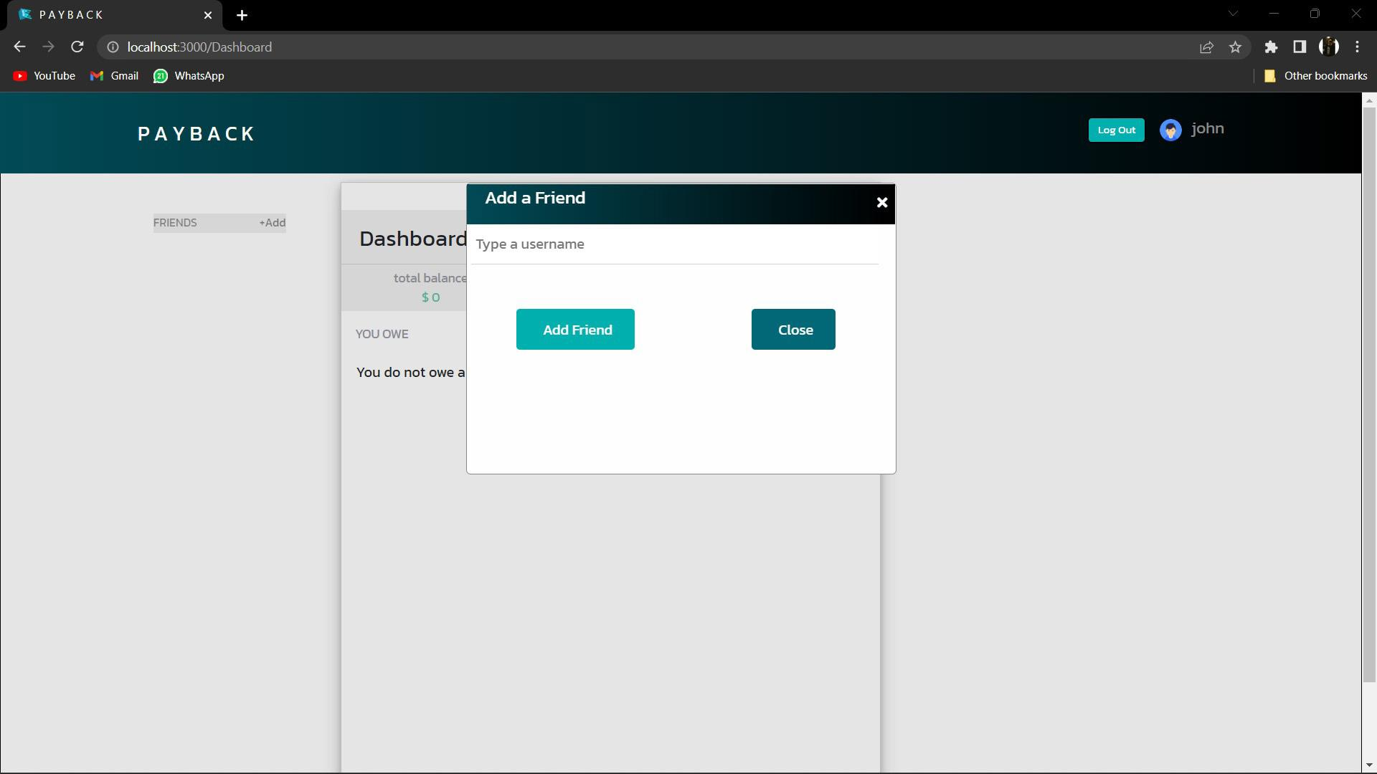
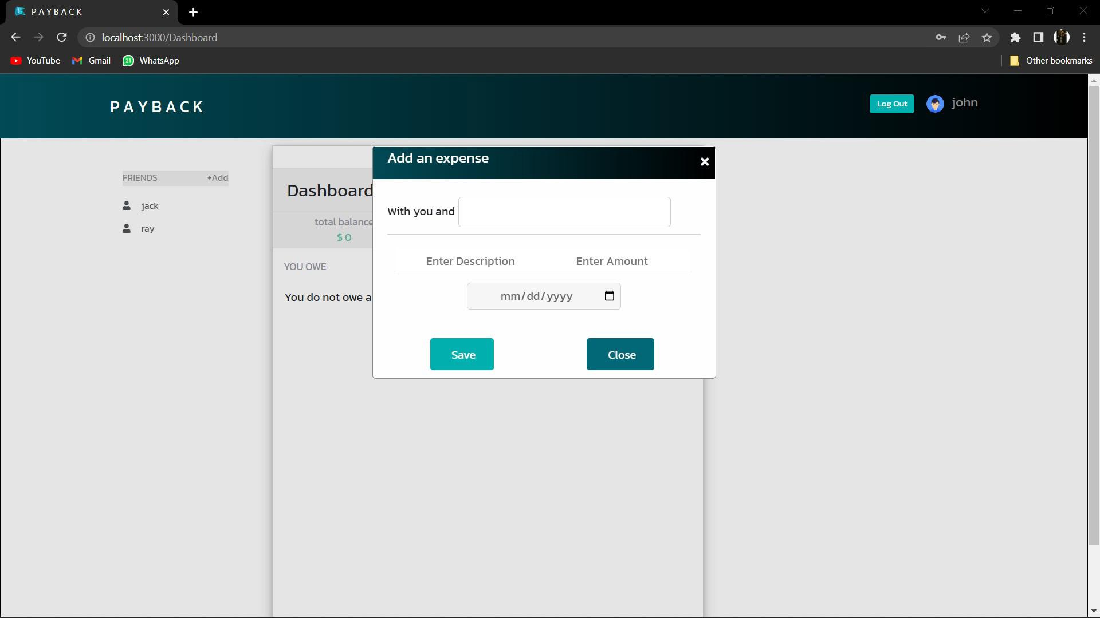
Screenshots :

Slide 11
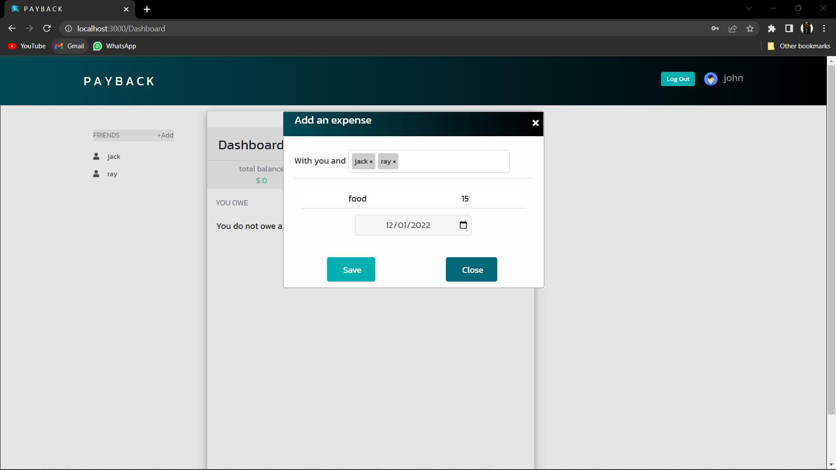
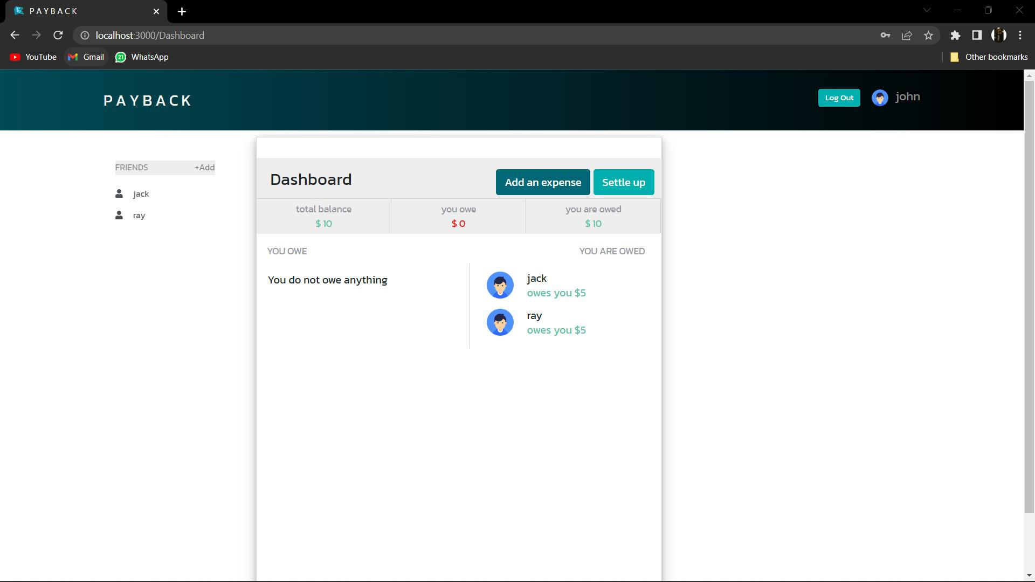
Screenshots :

Slide 12
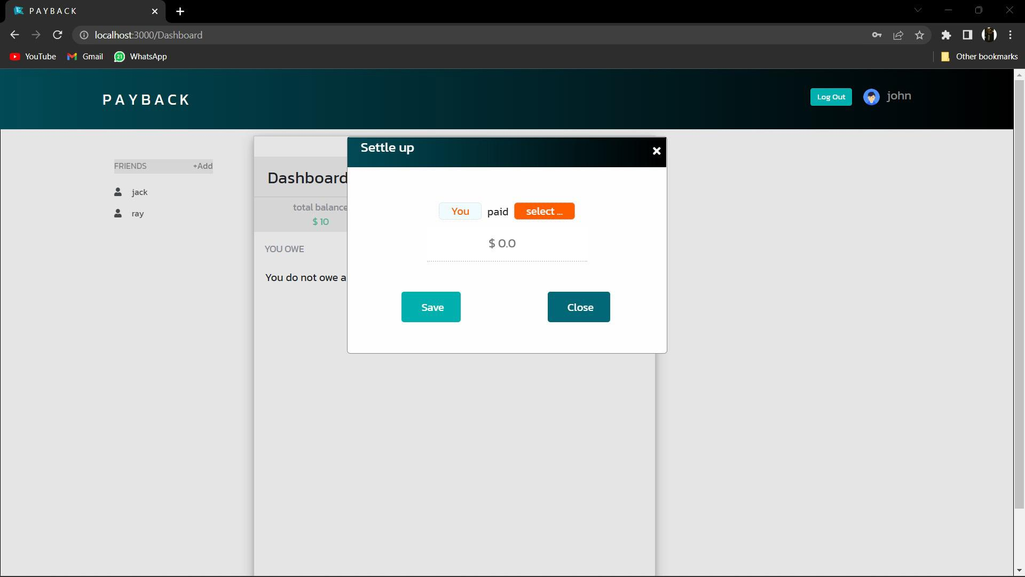
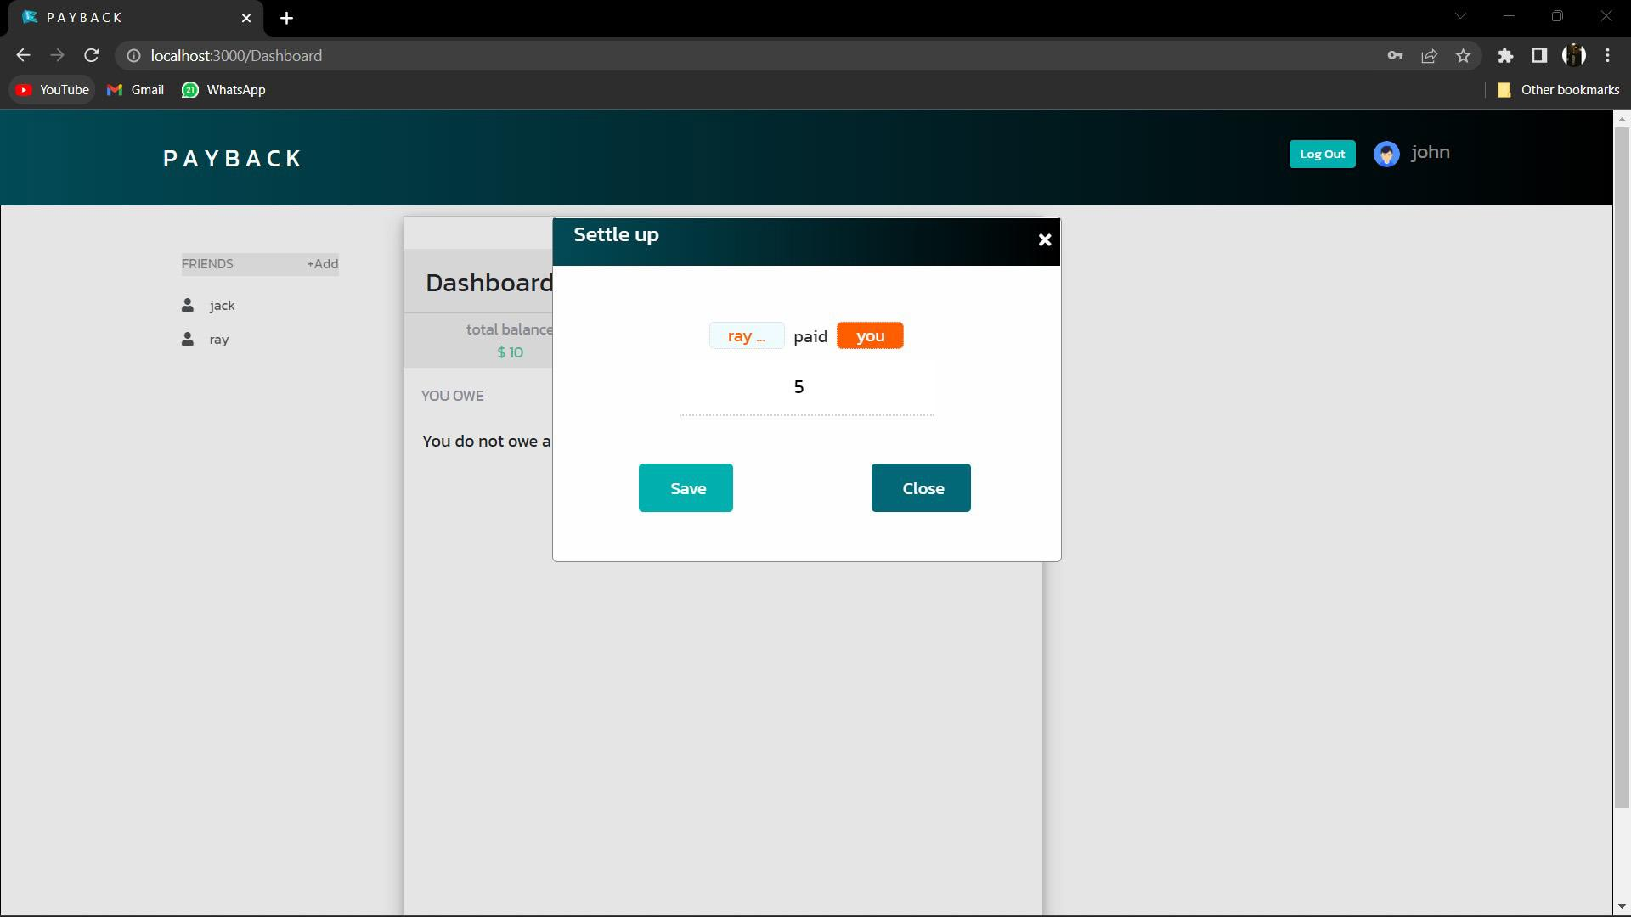
Screenshots :

Slide 13
Thank You !

